Slide 1
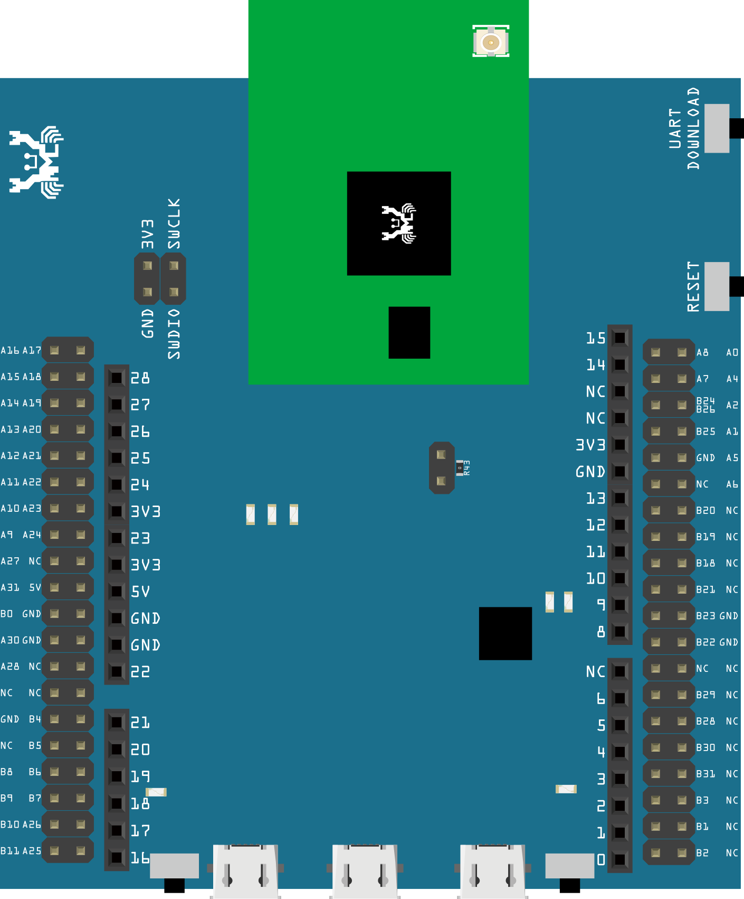
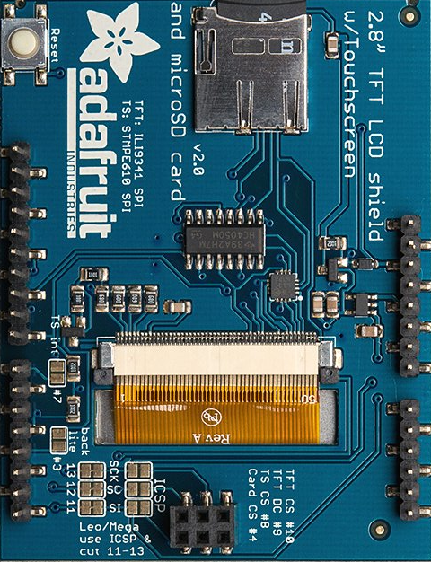
PMS3003
Connector
5V
GND
SET
Rx
Tx
RESET

Slide 2
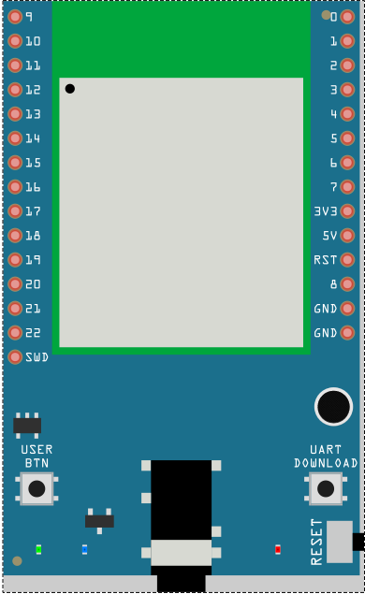
PMS3003
Connector
5V
GND
SET
Rx
Tx
RESET

Slide 3
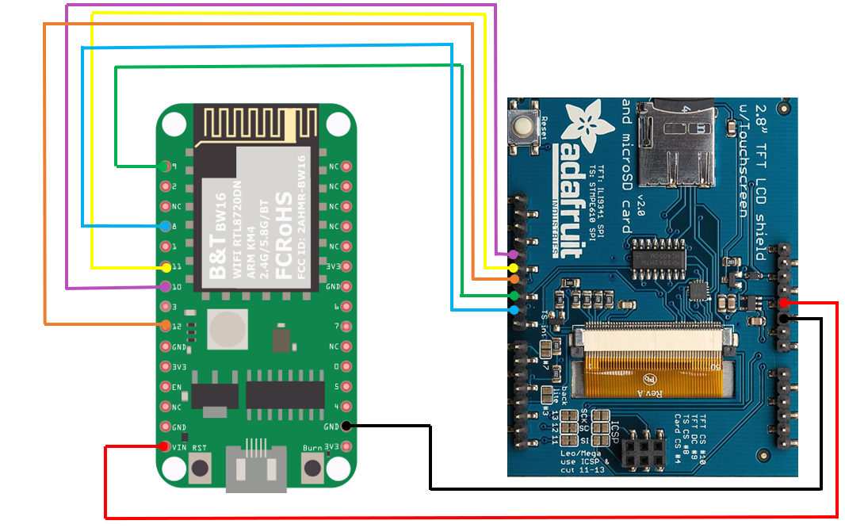
PMS3003
Connector
5V
GND
SET
Rx
Tx
RESET

Slide 4
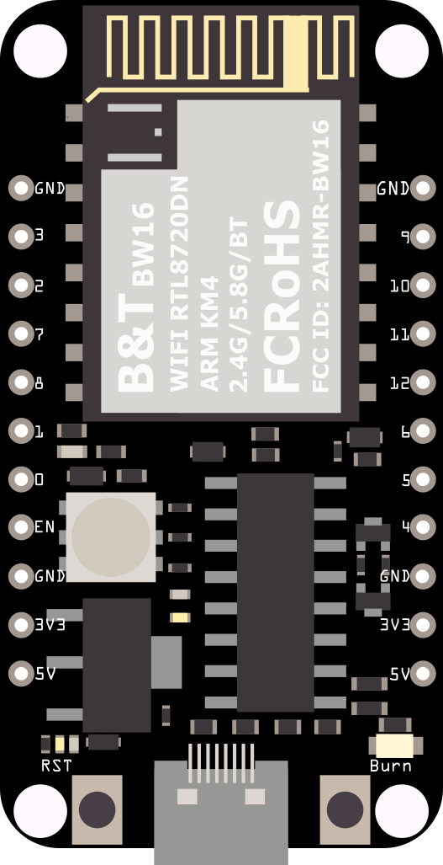
PMS3003
Connector
5V
GND
SET
Rx
Tx
RESET

